Slide 1
Legal and Ethical Aspects of Computer Security
Notes:
The legal and ethical aspects of computer security encompass a broad range of
topics, and a full discussion is well beyond the scope of this book. In this chapter, we
touch on a few important topics in this area.
The bulk of this book examines technical approaches to the detection, prevention,
and recovery from computer and network attacks. Chapters 16 and 17 examine
physical and human-factor approaches, respectively, to strengthening computer
security. All of these measures can significantly enhance computer security but
cannot guarantee complete success in detection and prevention. One other tool is
the deterrent factor of law enforcement. Many types of computer attacks can be
considered crimes and, as such, carry criminal sanctions. This section begins with a
classification of types of computer crime and then looks at some of the unique law
enforcement challenges of dealing with computer crime.

Slide 2
“Computer crime, or cybercrime, is a term used broadly to describe criminal activity in which computers or computer networks are a tool, a target, or a place of criminal activity.”
--From the New York Law School Course on
Cybercrime, Cyberterrorism, and Digital
Law Enforcement
Notes:
Computer crime, or cybercrime, is a term used broadly to describe criminal activity
in which computers or computer networks are a tool, a target, or a place of criminal
activity. These categories are not exclusive, and many activities can be characterized
as falling in one or more categories. The term cybercrime has a connotation of
the use of networks specifically, whereas computer crime may or may not involve
networks.

Slide 3
Types of Computer Crime
The U.S. Department of Justice categorizes computer crime based on the role that the computer plays in the criminal activity:
Computers as targets
Involves an attack on data integrity, system integrity, data confidentiality, privacy, or availability
Computers as storage devices
Using the computer to store stolen password lists, credit card or calling card numbers, proprietary corporate information, pornographic image files, or pirated commercial software
Computers as communications tools
Crimes that are committed online, such as fraud, gambling, child pornography, and the illegal sale of prescription drugs, controlled substances, alcohol, or guns
Notes:
The U.S. Department of Justice [DOJ00] categorizes computer crime based
on the role that the computer plays in the criminal activity, as follows:
• Computers as targets: This form of crime targets a computer system, to
acquire information stored on that computer system, to control the target
system without authorization or payment (theft of service), or to alter the
integrity of data or interfere with the availability of the computer or server.
Using the terminology of Chapter 1 , this form of crime involves an attack on
data integrity, system integrity, data confidentiality, privacy, or availability.
• Computers as storage devices: Computers can be used to further unlawful
activity by using a computer or a computer device as a passive storage medium.
For example, the computer can be used to store stolen password lists, credit
card or calling card numbers, proprietary corporate information, pornographic
image files, or “warez” (pirated commercial software).
• Computers as communications tools: Many of the crimes falling within this
category are simply traditional crimes that are committed online. Examples
include the illegal sale of prescription drugs, controlled substances, alcohol,
and guns; fraud; gambling; and child pornography.

Slide 4
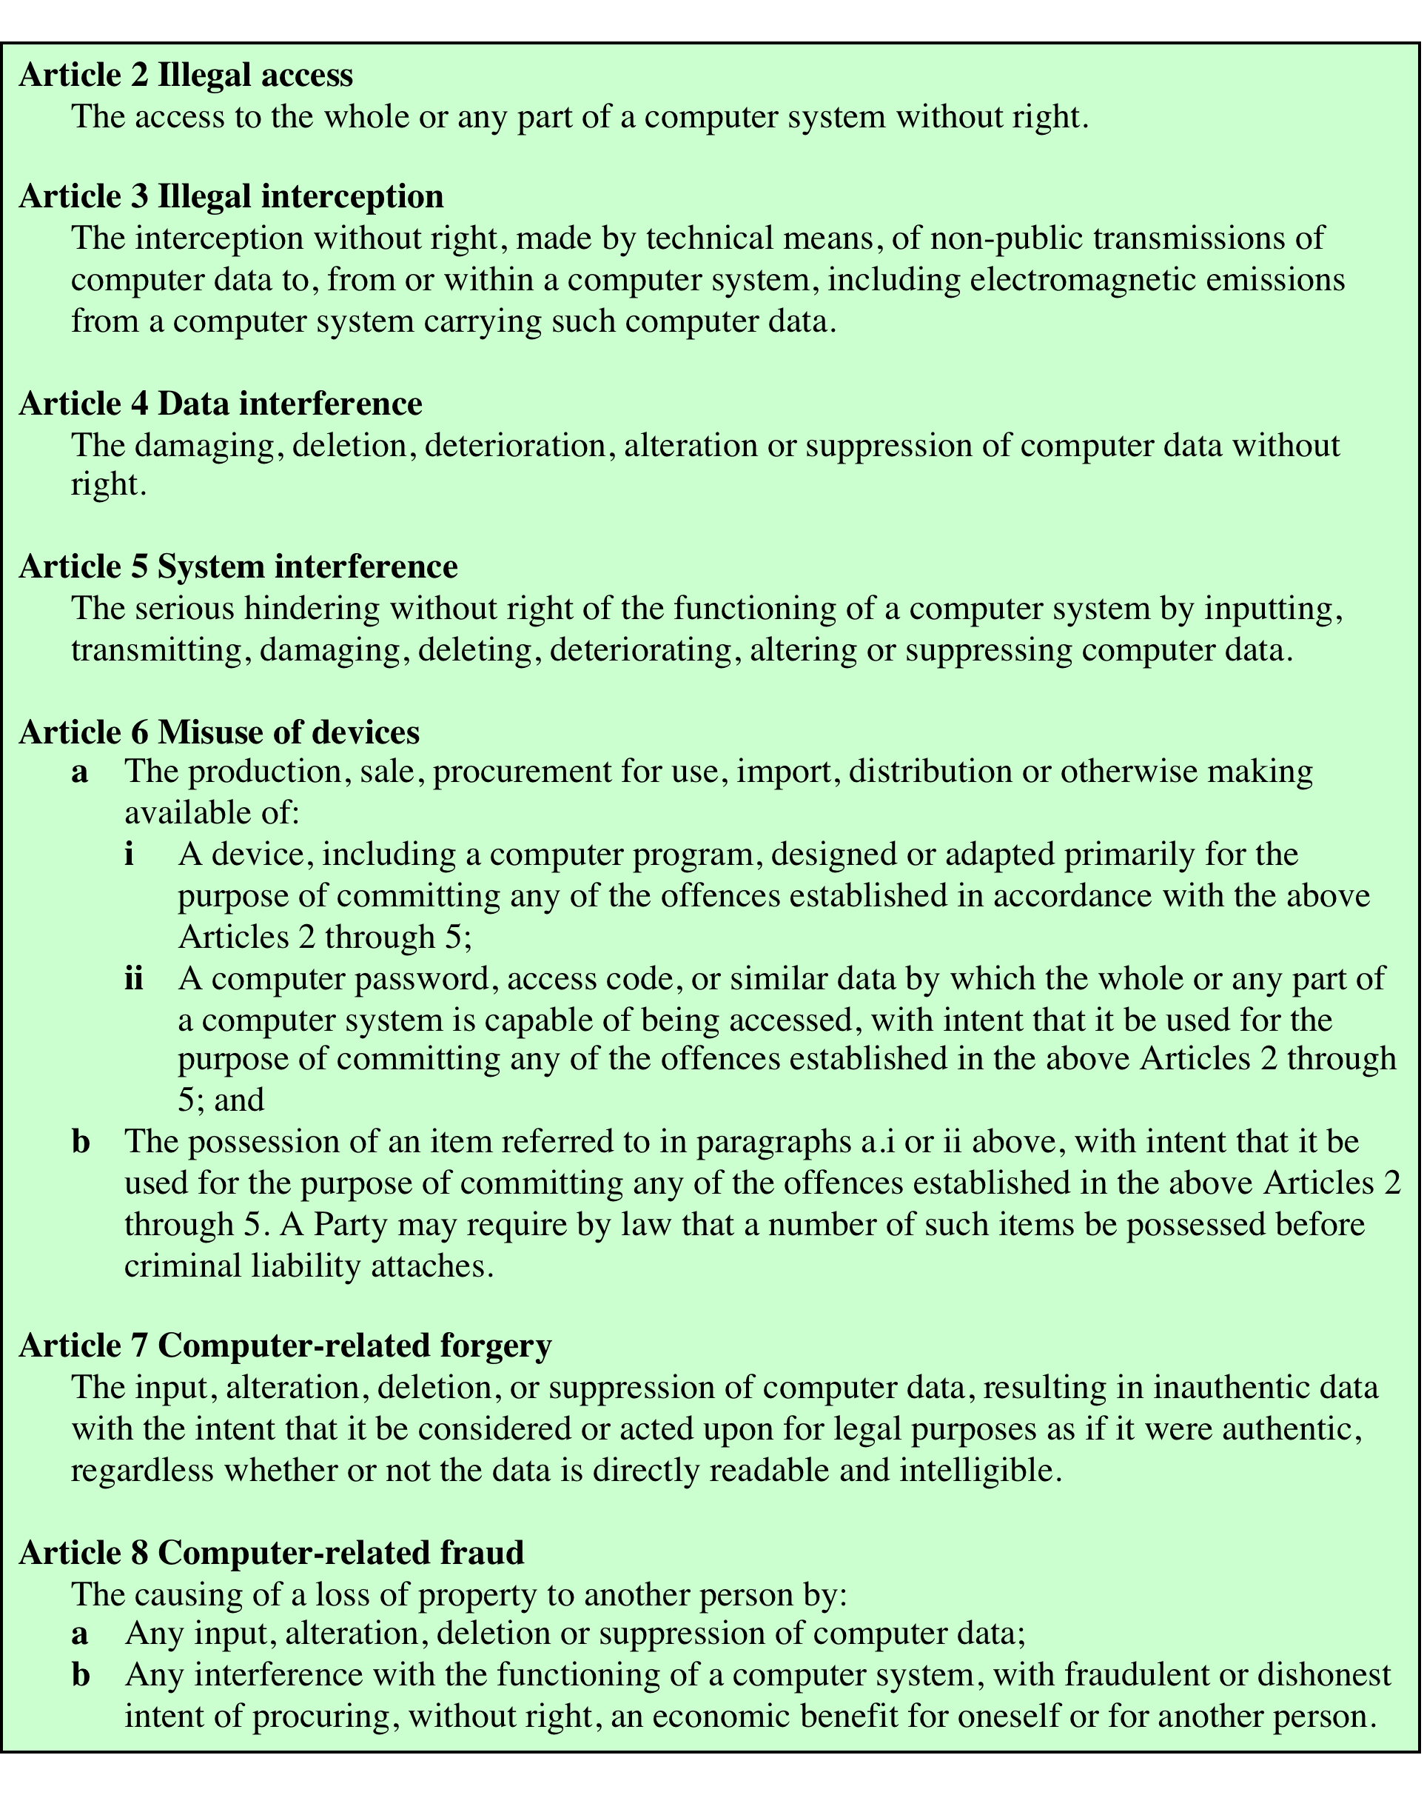
Table 19.1 Cybercrimes Cited in the Convention on Cybercrime (page 1 of 2)
Notes:
A more specific list of crimes, shown in Table 19.1 , is defined in the
international Convention on Cybercrime. This is a useful list because it represents
an international consensus on what constitutes computer crime, or cybercrime, and
what crimes are considered important.

Slide 5
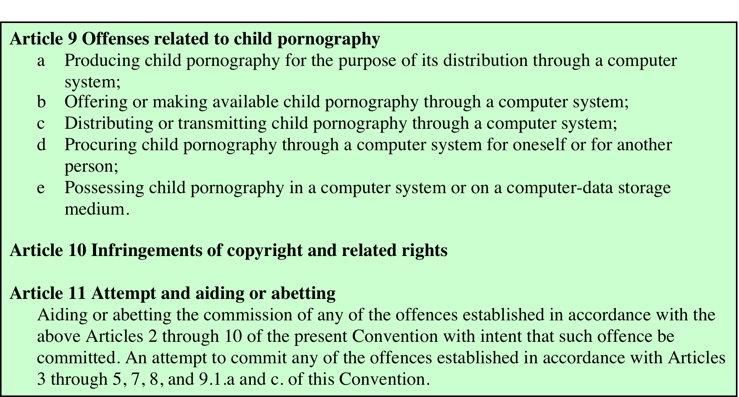
Table 19.1 Cybercrimes Cited in the Convention on Cybercrime (page 2 of 2)
Notes:
Table 19.1 Cybercrimes Cited in the Convention on Cybercrime. Page 2 of 2.

Slide 6
Law Enforcement Challenges
The deterrent effect of law enforcement on computer and network attacks correlates with the success rate of criminal arrest and prosecution
Law enforcement agency difficulties:
Lack of investigators knowledgeable and experienced in dealing with this kind of crime
Required technology may be beyond their budget
The global nature of cybercrime
Lack of collaboration and cooperation with remote law enforcement agencies
Convention on Cybercrime introduces a common terminology for crimes and a framework for harmonizing laws globally
Notes:
The deterrent effect of law enforcement on computer and network attacks correlates
with the success rate of criminal arrest and prosecution. The nature of cybercrime
is such that consistent success is extraordinarily difficult. To see this, consider what
[KSHE06] refers to as the vicious cycle of cybercrime, involving law enforcement
agencies, cybercriminals, and cybercrime victims.
For law enforcement agencies, cybercrime presents some unique difficulties.
Proper investigation requires a fairly sophisticated grasp of the technology.
Although some agencies, particularly larger agencies, are catching up in this
area, many jurisdictions lack investigators knowledgeable and experienced in
dealing with this kind of crime. Lack of resources represents another handicap.
Some cybercrime investigations require considerable computer processing
power, communications capacity, and storage capacity, which may be beyond the
budget of individual jurisdictions. The global nature of cybercrime is an additional
obstacle: Many crimes will involve perpetrators who are remote from the target
system, in another jurisdiction or even another country. A lack of collaboration and
cooperation with remote law enforcement agencies can greatly hinder an investigation.
Initiatives such as international Convention on Cybercrime are a promising
sign. The Convention at least introduces a common terminology for crimes and a
framework for harmonizing laws globally.

Slide 7
Cybercriminals
The lack of success in bringing them to justice has led to an increase in their numbers, boldness, and the global scale of their operations
Are difficult to profile
Tend to be young and very computer-savvy
Range of behavioral characteristics is wide
No cybercriminal databases exist that can point to likely suspects
Notes:
The relative lack of success in bringing cybercriminals to justice has led to an
increase in their numbers, boldness, and the global scale of their operations. It is
difficult to profile cybercriminals in the way that is often done with other types of
repeat offenders. The cybercriminal tends to be young and very computer-savvy,
but the range of behavioral characteristics is wide. Further, there exist no cybercriminal
databases that can point investigators to likely suspects.

Slide 8
Cybercrime Victims
Are influenced by the success of cybercriminals and the lack of success of law enforcement
Many of these organizations have not invested sufficiently in technical, physical, and human-factor resources to prevent attacks
Reporting rates tend to be low because of a lack of confidence in law enforcement, concern about corporate reputation, and a concern about civil liability
Notes:
The success of cybercriminals, and the relative lack of success of law enforcement,
influence the behavior of cybercrime victims. As with law enforcement, many
organizations that may be the target of attack have not invested sufficiently in technical,
physical, and human-factor resources to prevent attacks. Reporting rates tend to
be low because of a lack of confidence in law enforcement, a concern about corporate
reputation, and a concern about civil liability. The low reporting rates and the
reluctance to work with law enforcement on the part of victims feeds into the handicaps
under which law enforcement works, completing the vicious cycle.
Executive management and security administrators need to look upon law enforcement
as another resource and tool, alongside technical, physical, and human-factor
resources. The successful use of law enforcement depends much more on people
skills than technical skills. Management needs to understand the criminal investigation
process, the inputs that investigators need, and the ways in which the victim can
contribute positively to the investigation.

Slide 9
Working with Law Enforcement
Executive management and security administrators need to look upon law enforcement as a resource and tool
Management needs to:
Understand the criminal investigation process
Understand the inputs that investigators need
Understand the ways in which the victim can contribute positively to the investigation
Notes:
Executive management and security administrators need to look upon law enforcement
as another resource and tool, alongside technical, physical, and human-factor
resources. The successful use of law enforcement depends much more on people
skills than technical skills. Management needs to understand the criminal investigation
process, the inputs that investigators need, and the ways in which the victim can
contribute positively to the investigation.

Slide 10
Intellectual Property Relevant to Network and Computer Security
A number of forms of intellectual property are relevant in the context of network and computer security
Examples of some of the most prominent:
Software
Programs produced by vendors of commercial software
Shareware
Proprietary software created by an organization for internal use
Software produced by individuals
Databases
Data that is collected and organized in such a fashion that it has potential commercial value
Digital content
Includes audio and video files, multimedia courseware, Web site content, and any other original digital work
Algorithms
An example of a patentable algorithm is the RSA public-key cryptosystem
Notes:
A number of forms of intellectual property are relevant in the context of network
and computer security. Here we mention some of the most prominent:
• Software: This includes programs produced by vendors of commercial software
(e.g., operating systems, utility programs, applications) as well as shareware,
proprietary software created by an organization for internal use, and software
produced by individuals. For all such software, copyright protection is available if
desired. In some cases, a patent protection may also be appropriate.
• Databases: A database may consist of data that is collected and organized in
such a fashion that it has potential commercial value. An example is an economic
forecasting database. Such databases may be protected by copyright.
• Digital content: This category includes audio files, video files, multimedia,
courseware, Web site content, and any other original digital work that can be
presented in some fashion using computers or other digital devices.
• Algorithms: An example of a patentable algorithm, previously cited, is the
RSA public-key cryptosystem.
The computer security techniques discussed in this book provide some protection
in some of the categories mentioned above. For example, a statistical database
is intended for use in such a way as to produce statistical results, without the user
having access to the raw data. Various techniques for protecting the raw data are
discussed in Chapter 5. On the other hand, if a user is given access to software, such
as an operating system or an application, it is possible for the user to make copies
of the object image and distribute the copies or use them on machines for which a
license has not been obtained. In such cases, legal sanctions rather than technical
computer security measures are the appropriate tool for protection.

Slide 11
Ethical Issues
Many potential misuses and abuses of information and electronic communication that create privacy and security problems
Basic ethical principles developed by civilizations apply
Unique considerations surrounding computers and information systems
Scale of activities not possible before
Creation of new types of entities for which no agreed ethical rules have previously been formed
Ethics:
“A system of moral principles that relates to the benefits and harms of particular actions, and to the rightness and wrongness of motives and ends of those actions.”
Notes:
Because of the ubiquity and importance of information systems in organization of
all types, there are many potential misuses and abuses of information and electronic
communication that create privacy and security problems. In addition to questions
of legality, misuse and abuse raise concerns of ethics. Ethics refers to a system of
moral principles that relates to the benefits and harms of particular actions, and to
the rightness and wrongness of motives and ends of those actions. In this section,
we look at ethical issues as they relate to computer and information system security.
To a certain extent, a characterization of what constitutes ethical behavior for
those who work with or have access to information systems is not unique to this
context. The basic ethical principles developed by civilizations apply. However,
there are some unique considerations surrounding computers and information
systems. First, computer technology makes possible a scale of activities not
possible before. This includes a larger scale of recordkeeping, particularly on individuals,
with the ability to develop finer-grained personal information collection
and more precise data mining and data matching. The expanded scale of communications
and the expanded scale of interconnection brought about by the Internet
magnify the power of an individual to do harm. Second, computer technology has
involved the creation of new types of entities for which no agreed ethical rules
have previously been formed, such as databases, Web browsers, chat rooms, cookies,
and so on.

Slide 12
Notes:
Further, it has always been the case that those with special knowledge or
special skills have additional ethical obligations beyond those common to all
humanity. We can illustrate this in terms of an ethical hierarchy ( Figure 19.5 ), based
on one discussed in [GOTT99]. At the top of the hierarchy are the ethical values
professionals share with all human beings, such as integrity, fairness, and justice.
Being a professional with special training imposes additional ethical obligations
with respect to those affected by his or her work. General principles applicable to
all professionals arise at this level. Finally, each profession has associated with it
specific ethical values and obligations related to the specific knowledge of those
in the profession and the powers that they have to affect others. Most professions
embody all of these levels in a professional code of conduct, a subject discussed
subsequently.

Slide 13
Ethical Issues Related to Computers and Information Systems
Some ethical issues from computer use:
Repositories and processors of information
Producers of new forms and types of assets
Instruments of acts
Symbols of intimidation and deception
Those who understand, exploit technology, and have access permission, have power over these
Notes:
Let us turn now more specifically to the ethical issues that arise from computer
technology. Computers have become the primary repository of both personal information
and negotiable assets, such as bank records, securities records, and other
financial information. Other types of databases, both statistical and otherwise, are
assets with considerable value. These assets can only be viewed, created, and altered
by technical and automated means. Those who can understand and exploit the
technology, plus those who have obtained access permission, have power related to
those assets.
A classic paper on computers and ethics [PARK88] points out that ethical
issues arise as the result of the roles of computers, such as the following:
• Repositories and processors of information: Unauthorized use of otherwise
unused computer services or of information stored in computers raises questions
of appropriateness or fairness.
• Producers of new forms and types of assets: For example, computer programs
are entirely new types of assets, possibly not subject to the same concepts of
ownership as other assets.
• Instruments of acts: To what degree must computer services and users of computers,
data, and programs be responsible for the integrity and appropriateness
of computer output?
• Symbols of intimidation and deception: The images of computers as thinking
machines, absolute truth producers, infallible, subject to blame, and as anthropomorphic
replacements of humans who err should be carefully considered.

Slide 14
Professional/Ethical Responsibilities
Concern with balancing professional responsibilities with ethical or moral responsibilities
Types of ethical areas a computing or IT professional may face:
Ethical duty as a professional may come into conflict with loyalty to employer
“Blowing the whistle”
Expose a situation that can harm the public or a company’s customers
Potential conflict of interest
Organizations have a duty to provide alternative, less extreme opportunities for the employee
In-house ombudsperson coupled with a commitment not to penalize employees for exposing problems
Professional societies should provide a mechanism whereby society members can get advice on how to proceed
Notes:
We are concerned with balancing professional responsibilities with ethical
or moral responsibilities. We cite two areas here of the types of ethical questions
that face a computing or IT professional. The first is that IT professionals may find
themselves in situations where their ethical duty as professionals comes into conflict
with loyalty to their employer. Such a conflict may give rise for an employee
to consider “blowing the whistle,” or exposing a situation that can harm the public
or a company’s customers. For example, a software developer may know that a
product is scheduled to ship with inadequate testing to meet the employer’s deadlines.
The decision of whether to blow the whistle is one of the most difficult that
an IT professional can face. Organizations have a duty to provide alternative, less
extreme opportunities for the employee, such as an in-house ombudsperson coupled
with a commitment not to penalize employees for exposing problems in-house.
Additionally, professional societies should provide a mechanism whereby society
members can get advice on how to proceed.
Another example of an ethical question concerns a potential conflict of interest.
For example, if a consultant has a financial interest in a certain vendor, this
should be revealed to any client if that vendor’s products or services might be recommended
by the consultant.

Slide 15
The Cybercrime Prevention Law in Qatar

Slide 16
Article(2) Crimes Pertaining to Hacking Information Systems
A person who manages through an Information Network or any information technology technique to have an unlawful access to a website or an information system belonging to a state authority, body or entity or any affiliated corporation shall be punished by imprisonment for a period not exceeding three (3) years and a fine of not more than QR500,000.
The punishment mentioned in the preceding paragraph shall be doubled if such access results in:
acquiring any electronic data or information:
acquiring any information or data pertaining to the State’s domestic or foreign security
or its national economy;
acquiring any government information which are deemed confidential by nature or by
way of specific instructions;
cancelling, destroying, damaging or publishing such electronic information or data;
inflicting damage on any beneficiaries or users; or
acquiring undeserved money, services or benefits.

Slide 17
Article (3)
A sentence of not more than three years in prison and a fine of not more than QR 500,000, or either of these penalties, shall be imposed on any person who
intentionally and illegally accesses in any way a website, an information system, an information network or an information technology technique or a part thereof;
exceeds authorized access; or
knowingly continues his visit or access thereof.
The punishment mentioned in the preceding paragraph shall be doubled if such access results in:
cancelling, deleting, adding, disclosing, destroying, changing, transferring, capturing, copying, publishing or republishing electronic data or information stored in an information system;
inflicting damage upon beneficiaries or users;
destroying, stopping or suspending a website, an information system or an information network; or
changing or deleting a website or changing its content, design or way of use or impersonating its owner or administrator.

Slide 18
Article (4)
A sentence of not more than two years in prison and a fine of not more than QR100,000, or either of these penalties, shall be imposed on any person who
unlawfully captures
intercepts or intentionally spies on any traffic data or any data being transmitted through an information network, or
any information technology technique.

Slide 19
Article (5)
A sentence of not more than three years in prison and a fine of not more than QR 500,000 shall be imposed on any person who
through an information network or an information technology technique sets up or runs a website for a terrorist group or organization,
facilitates communication with leaders and members of such group or organization, promotes its thoughts,
secures financing thereto or publishes information relating to manufacturing explosives or incendiary devices or any device that can be used in a terrorist act.

Slide 20
Article (6)
A sentence of not more than three years and a fine of not more than QR500,000, or either of these penalties, shall be imposed on any person who
through an information network or an information technology technique sets up or runs a website to publish false news to threaten the safety and security of the State or its public order or domestic and foreign security.
A sentence of not more than a year in a prison and a fine of not more than QR250,000, or either of these penalties, shall be imposed on any person who promotes, disseminates or publishes in any way such false news for the same purpose.

Slide 21
Article (10)
A sentence of not more than 10 years and a fine of not more than QR200,000 shall be imposed on any person who
forges an official electronic document or knowingly uses the same.
A sentence of not more than three years in prison and a fine of not more than QR100,000, or either of these penalties, shall be imposed on any person
forging an unofficial electronic document or knowingly using the same.

Slide 22
Article (11)
A sentence of not more than three years in prison and a fine of not more than QR100,000, or either of these penalties, shall be imposed on any person doing any of the following actions:
Uses an information network or information technology technique to impersonate a legal or natural person; or
Manages, through an information network or information technology technique, to seize, for himself or for another person, any movable or document, or secures signature of such document, by acting fraudulently, using a false name or impersonating someone.

Slide 23
Article (12)
A sentence of not more than three years in prison and a fine of not more than QR200,000, or either of these penalties, shall be imposed on any person who:
Unlawfully uses, accesses or gives access to numbers and data of an electronic transaction card through an information network or an information technology technique;
Forges an electronic transaction card in any way whatsoever;
Produces or possess, without a license, devices or material that may be used in issuing
forging an electronic transaction card;
Knowingly uses or facilities the use of a forged electronic transaction card; or
Knowingly accepts an invalid, forged or stolen electronic transaction card

Slide 24
Law No. (13) of 2016 on Protecting Personal Data Privacy

Slide 25
Article (3)
Each Individual has the right to the protection of the Personal Data thereof that shall be processed only within the framework of transparency, honesty, and respect of human dignity, and acceptable practices according to provisions hereof.

Slide 26
Article (5)
An individual may, at any time:
Withdraw the prior consent thereof for Personal Data Processing.
Object to processing the Personal Data thereof if such processing is
not necessary to achieve the purposes for which such Personal Data have been collected or where such collected Personal Data are beyond the extent required, discriminatory, unfair or illegal.
Request omission or erasure of the Personal Data thereof in any of the cases referred to in the preceding two items , upon cessation of the purpose for which the processing has been conducted, or where all justifications for maintaining such Personal Data by the Controller cease to exist.
Request corrections to the Personal Data thereof. A request so made shall be accompanied with proof of the accuracy of such request.

Slide 27
Article (6)
An Individual may, at any time, access the Personal Data thereof and apply to review the same, in facing any Controller, and an Individual has, in particular, the right to:
Be notified of processing the Personal Data thereof and the purposes for which such processing is conducted
Be notified of any disclosure of inaccurate Personal Data.
Obtain a copy of the Personal Data thereof after paying an amount that shall not exceed the service charge.

Slide 28
Article (8)
The Controller shall abide by the following:
Processing Personal Data honestly and legitimately.
Consider the controls related to designing, changing or developing products, systems and services pertinent to Personal Data Processing.
Taking appropriate administrative, technical and financial precautions to protect Personal Data, in accordance with what is determined by the Competent Department.
The privacy protecting policies developed by the Competent Department, and a decision thereon shall be issued by the Min

Slide 29
Article (9)
The Controller shall, prior to starting processing any Personal Data, inform the Individual with the following:
The Controller’s details or any other party conducting the processing for the Controller or to be used thereby.
The Lawful Purposes that the Controller or any other party wants to process the Personal Data therefor.
Comprehensive and accurate description of the processing activities and the levels of disclosure of such Personal Data for the Lawful Purposes, and if the Controller fails to do so, the Controller shall provide the Individual with a general description thereof.
Any other information that is necessary and required for fulfilling conditions of Personal Data Processing.

Slide 30
Article (13)
Each of the Controller and the Processor shall take the precautions necessary to protect Personal Data against
Loss
Damage
Change
Disclosure
access thereto, or
the inadvertent or illegal use thereof.

Slide 31
Article (16)
The Personal data, related to ethnic origin, children, health, physical or psychological condition, religious creeds, marital relations, and criminal offenses, shall be regarded as Personal data with special nature.

Slide 32
Article (17)
Taking into consideration the liabilities provided for hereto, an owner or operator of any website addressing children shall take into account the following:
Posting a notification on the website as to what child data is, the way of its use, and the policies followed in the disclosure thereof
Obtaining, either electronically or through any other appropriate means, an explicit consent from the guardian of the child whose Personal Data is processed.
Providing a child's guardian, upon the request thereof, and after verifying the identity thereof, with a description of the type of the Personal Data processed, along with stating the purpose of the process together with a copy of the data processed or gathered about the child.
Deleting, removing or suspending processing any Personal Data that has been gathered from or about a child, if such is requested by child's guardian.
A child’s participation in a game, promotional award or any other activity shall not be conditional on the child’s provision of Personal Data in excess of the necessary for the participation in such activity

Slide 33
Summary
Cybercrime and computer crime
Types of computer crime
Law enforcement challenges
Working with law enforcement
Ethical issues
Ethics and the IT professions
Ethical issues related to computers and information systems
Codes of conduct
The rules
Cybercrime prevention laws in Qatar
Notes:
Chapter 19 summary.

